Slide 1
Unit-2.5 Switching
Prepared By:
Prof. Vishal A. Polara
Assistant Professor
Information Technology Department
Birla Vishvakarma Mahavidyalaya Engineering College

Slide 2
Outline
Circuit switched networks
Datagram networks
Virtual circuit networks
Structure of switch

Slide 3
What is switching?
It is applied to avoid point to point connection between all the stations.
A switched network consists of a series of interlinked nodes, called switches.
Switches are devices capable of creating temporary connections between two or more devices linked to the switch. In switched network some of these nodes are connected to the end systems and others are used only for routing.
There are three traditional method of switching
Circuit switching
Packet switching
Message switching

Slide 4
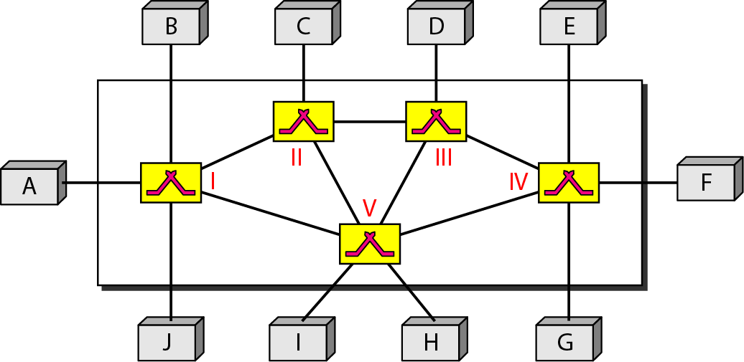
Figure Switched network

Slide 5
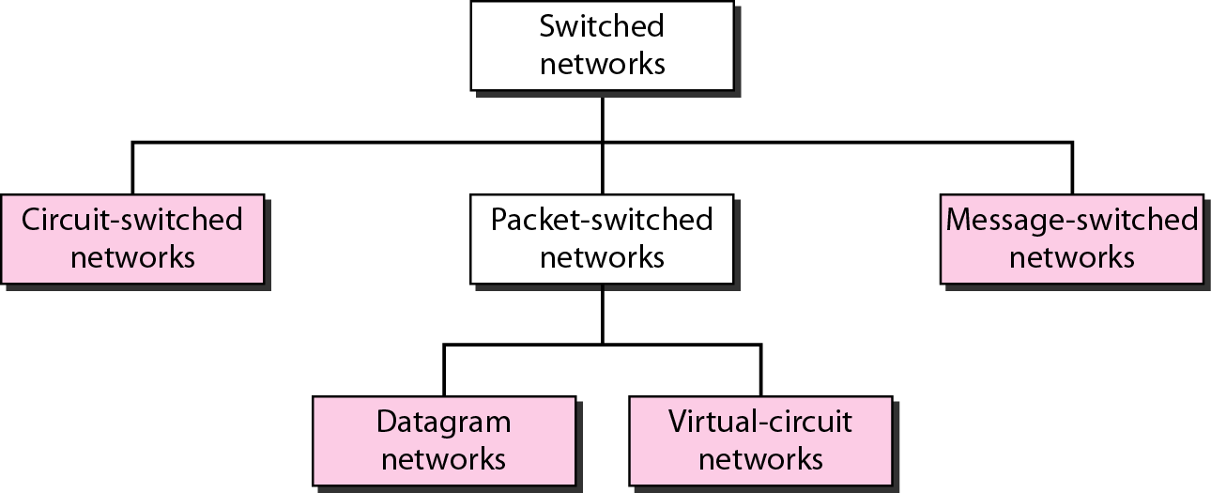
Figure Taxonomy of switched networks

Slide 6
1. CIRCUIT-SWITCHED NETWORKS
A circuit-switched network is made of a set of switches connected by physical links, in which each link is divided into n channels.
In circuit switching, the resources need to be reserved during the setup phase; the resources remain dedicated for the entire duration of data transfer until the teardown phase.
Circuit Switching is carried out in three phase:
1. Setup phase:
When end system wants to communicate with each other. Sender needs to request a connection to receiver that must be accepted by all switches.
In this phase two parties needs to established dedicated circuit. Creating connection between dedicated lines to the switches.

Slide 7
Fig shows when system A needs to connect to system M it sends a setup request that includes the address of system M to switch I then next upcoming switches find path to M.
To established complete connection an acknowledgment from system M needs to be sent in the opposite direction to system A.
Here end to end addressing is required for creating connection.
Address of computer is required in case of TDM and telephone numbers in FDM network.
2. Data transfer:
- In this phase data transfer take place after getting dedicated path between two stations
3. Tear down phase:
- In this phase after all data have been transferred the circuits are tear down.

Slide 8
Point to be noted:
Circuit switching takes place at physical layer.
Before starting communication the stations must make a reservation for the resources like channels, switch buffers, switch processing time, and switch input/output ports remain dedicated until the tear down phase.
Data transferred between the two stations are not packetized. There may be a gap of data.
There is no addressing involved during data transfer. The switches route the data based on their occupied band(FDM) or time slot(TDM).

Slide 9
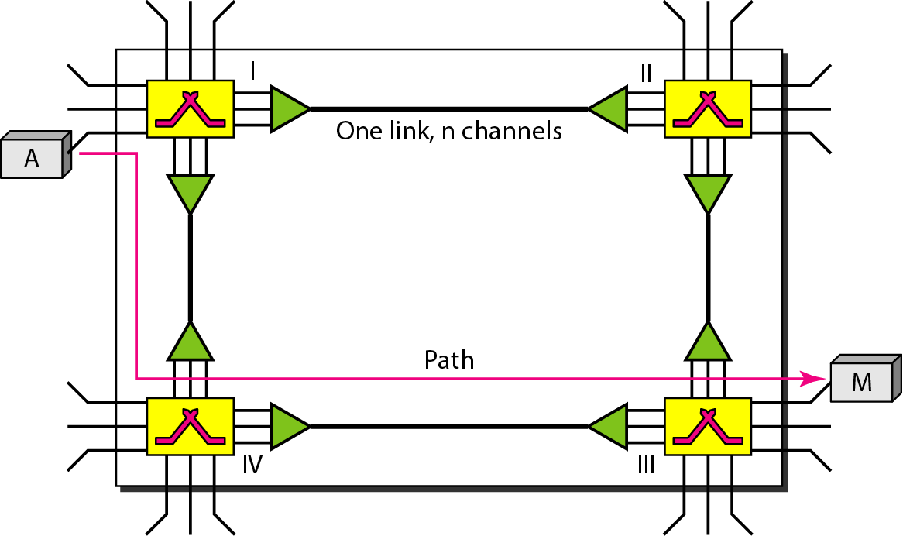
Figure A trivial circuit-switched network

Slide 10
Efficiency
It is not efficient method because resources are dedicated for a particular connection during entire duration.
Delay
Delay is minimal in this type of network because resources are allocated for that purpose only.
There is no waiting time at each switch. The total delay is due to the time needed to create the connection, transfer data, and disconnect the circuit.
Delay caused by setup due to four parts : propagation time of computer request, the request signal transfer time, acknowledge transfer time, and the signal transfer time of the acknowledgement.
Delay due to transfer is due to the propagation time and data transfer time.

Slide 11
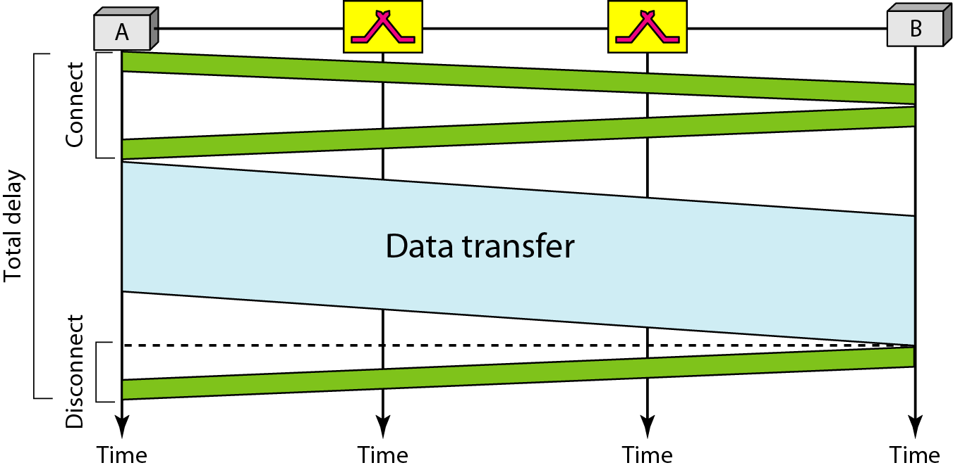
Figure Delay in a circuit-switched network

Slide 12
Switching at the physical layer in the traditional telephone network uses
the circuit-switching approach.

Slide 13
2. Datagram Networks
In data gram networks the message is going to pass through a packet switched network, it needs to be divided into packets of fixed or variable size. Size of packet is depend on governing protocol.
In packet switching there is no resource allocation for a packet. No reserved bandwidth on the links there is no scheduled processing time for each packet. Resources are allocated on demand.
Resource allocation is on first come first serve basis.
Packets in this approach are referred to as datagram. It is normally done at the network layer.
In datagram network switches are consider as a router.
It is also known as connection less network that means switch does not keep information about the connection state.

Slide 14
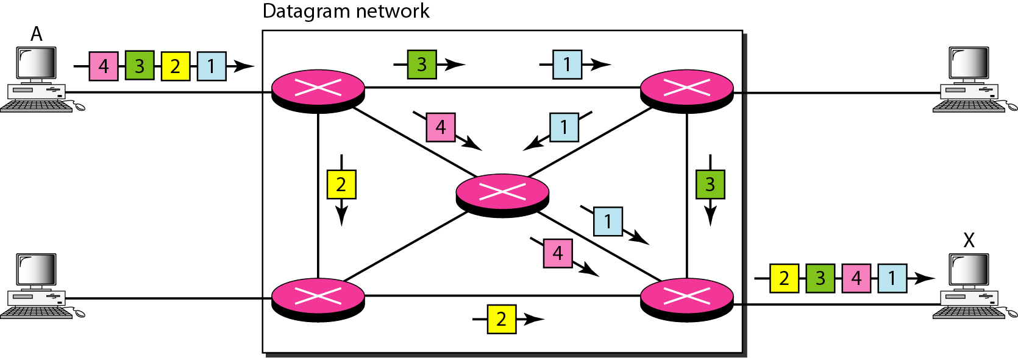
In a packet-switched network, there is no resource reservation;
resources are allocated on demand.
Figure A datagram network with four switches (routers)

Slide 15
Routing Table
In data gram network there is no setup or teardown phases so it is necessary to have some mechanism in order to track packets.
In this network each switch has routing table which is based on the destination address. It is dynamic and updated periodically.
The destination address and the corresponding forwarding output ports are recorded in the tables.
Each packet in datagram contain header which include destination address, when the switch receives the packet.
Here destination address remains the same during the entire journey of the packet.

Slide 16
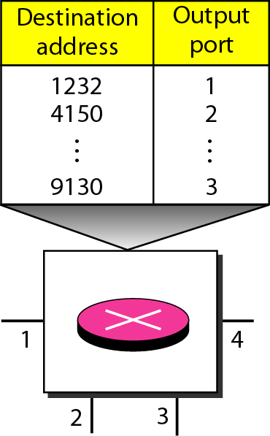
A switch in a datagram network uses a routing table that is based on the destination address.
Figure Routing table in a datagram network

Slide 17
The destination address in the header of a packet in a datagram network
remains the same during the entire journey of the packet.

Slide 18
Efficiency:
It is better than circuit switched network because resources are allocated only when there are packets to be transferred.
Delay:
It has more delay than circuit switched network because of no phase.
Packet must have to wait at switch before it is forwarded.
The delay is not uniform for packet as it is travelled from different switches.
There are three transmission time(3T), three propagation time(3t) if packet travels through two switches so three delay.
And two waiting time. We ignore the processing time in each switch the total delay is
Total delay = 3T +3t + w1 +w2

Slide 19
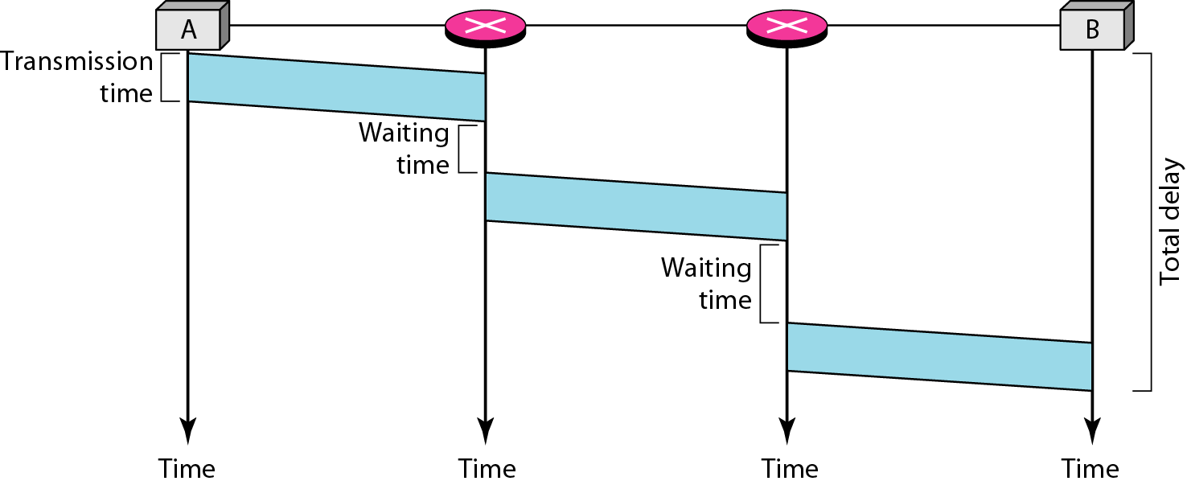
Figure Delay in a datagram network

Slide 20
3. Virtual circuit networks
A virtual-circuit network is a cross between a circuit-switched network and a datagram network. It has some characteristics of both.
There are three phase like circuit switched network.
Resources can be allocated during the setup phase as circuit switched network or on demand as datagram networks.
Data are packetized and each packet carries an address in the header.
All packets follow the same path established during the connection as circuit switched network.
It is normally implemented in data link layer, while circuit switched network in physical and datagram network in network layer.

Slide 21
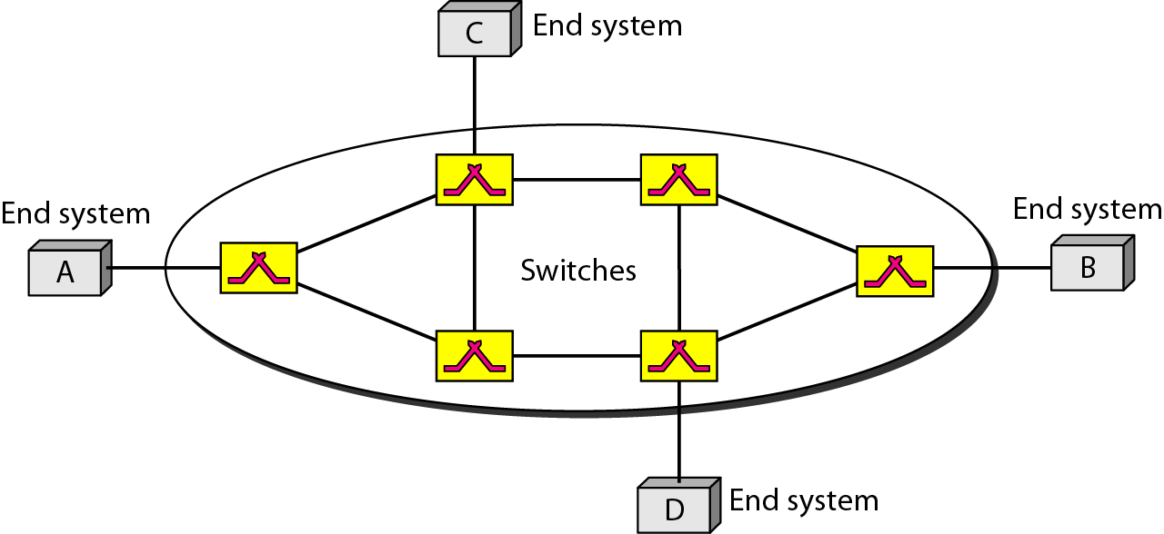
Figure Virtual-circuit network

Slide 22
Addressing
There are two types of addressing involved: Global and local
Global Addressing:
A source or a destination needs to have a global address and address that can be unique in the scope of the network or internationally if the network is part of an international network.
Virtual Circuit identifier:
The identifier that is actually used for data transfer is called the virtual-circuit identifier.
Unlike a global address is a small number that has only switch scope, it is used by a frame between two switches. When a frame arrives at a switch it has a VCI, when it leaves it has a different VCI.
VCI does not need to be a large number since each switch can use its own unique set of VCIs.

Slide 23
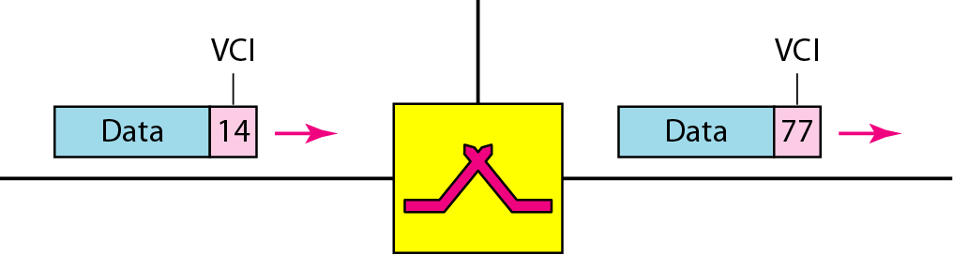
Figure Virtual-circuit identifier

Slide 24
Three phases
In the setup phase the source and destination use their global addresses to help switches make table entries for the connection.
Data transfer phase:
All switches have a table entry for virtual circuit.
It has four columns. Incoming port and VCI and outgoing port and VCI.
It is active until all frame send by source to destination. It creates virtual circuit not a real circuit between source and destination.
Setup phase:
In this phase a switch creates an entry for a virtual circuit. It requires the setup request and the acknowledgement.

Slide 25
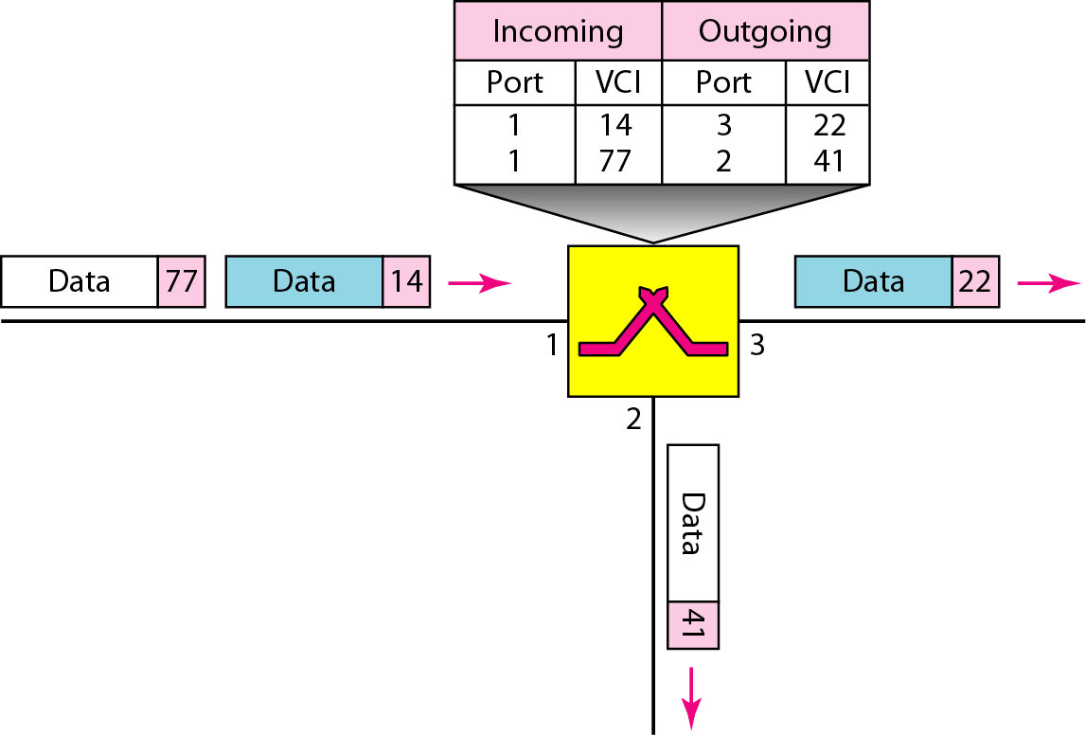
Figure Switch and tables in a virtual-circuit network

Slide 26
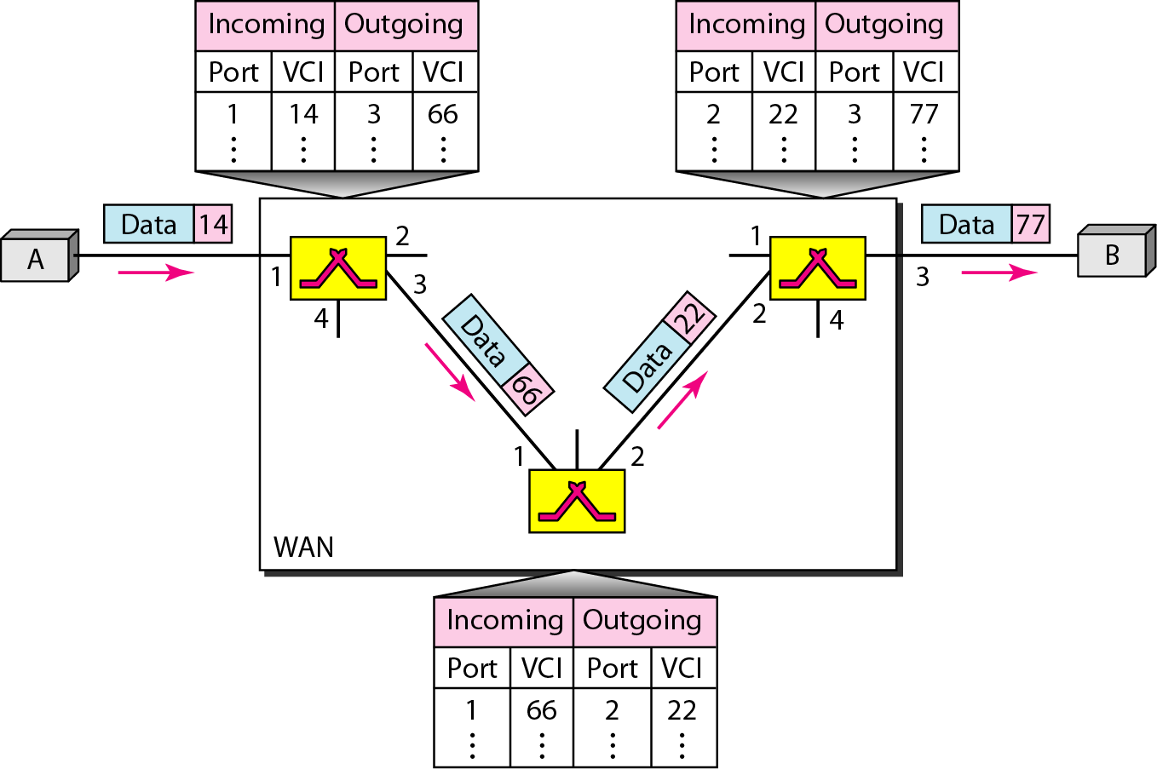
Figure Source-to-destination data transfer in a virtual-circuit network

Slide 27
Setup request:
A setup request frame is sent from the source to the destination.
Switch 1 receives the setup request frame based on that it assign incoming port and available VCI and the outgoing port , outgoing VCI found during acknowledgment step.
This process happen at each switch and frame reaches to B.
Acknowledgment:
A special frame called the acknowledgment frame completes the entries in the switching tables.
The destination sends an acknowledgment to switch 3. The acknowledgment carries the global source and destination addresses so the switch knows which entry in the table is to be completed.
The frame is also carries VCI chose by destination as the incoming VCI for frames from A.
It completes column using this VCI which is incoming VCI of destination B.
This process is carried out by each switch.
Now source use this outgoing VCI for the data frame to be sent to destination B.

Slide 28
Teardown phase:
In this phase source A, after sending all frames to B, sends a special frame called a teardown request. Destination B responds with a teardown confirmation frame.
All switches delete the corresponding entry from their tables.
Efficiency:
In the first case delay is same for each packet, in second case it is different.
When resource allocation is on demand, The source can check the availability of the resources without actually reserving it. That is big advantage of this scheme. Example restaurant reservation.
Delay:
There is one time delay for setup and for teardown. If resources are allocated during the setup phase there is no wait time for individual packets.
Packet travel through two switches. There are three transmission tiem(3T), three propagation time(3t), a setup delay and teardown delay
Total delay = 3T + 3t + setup delay + teardown delay.

Slide 29
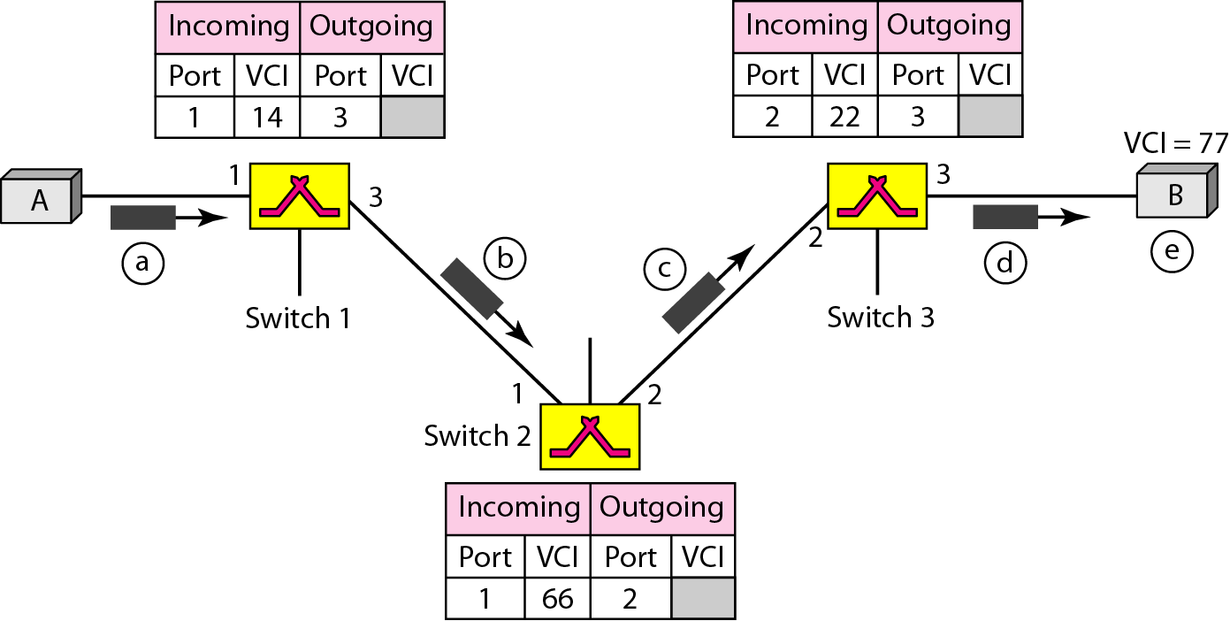
Figure Setup request in a virtual-circuit network

Slide 30
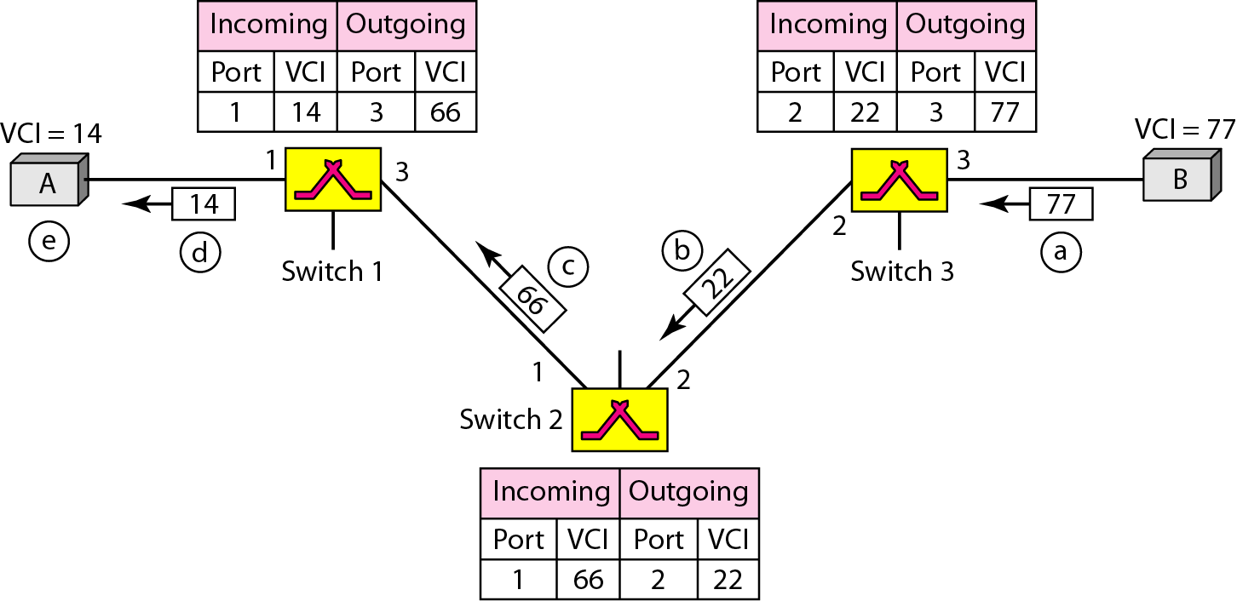
Figure Setup acknowledgment in a virtual-circuit network

Slide 31
In virtual-circuit switching, all packets belonging to the same source and destination travel the same path;
but the packets may arrive at the destination with different delays if resource allocation is on demand.

Slide 32
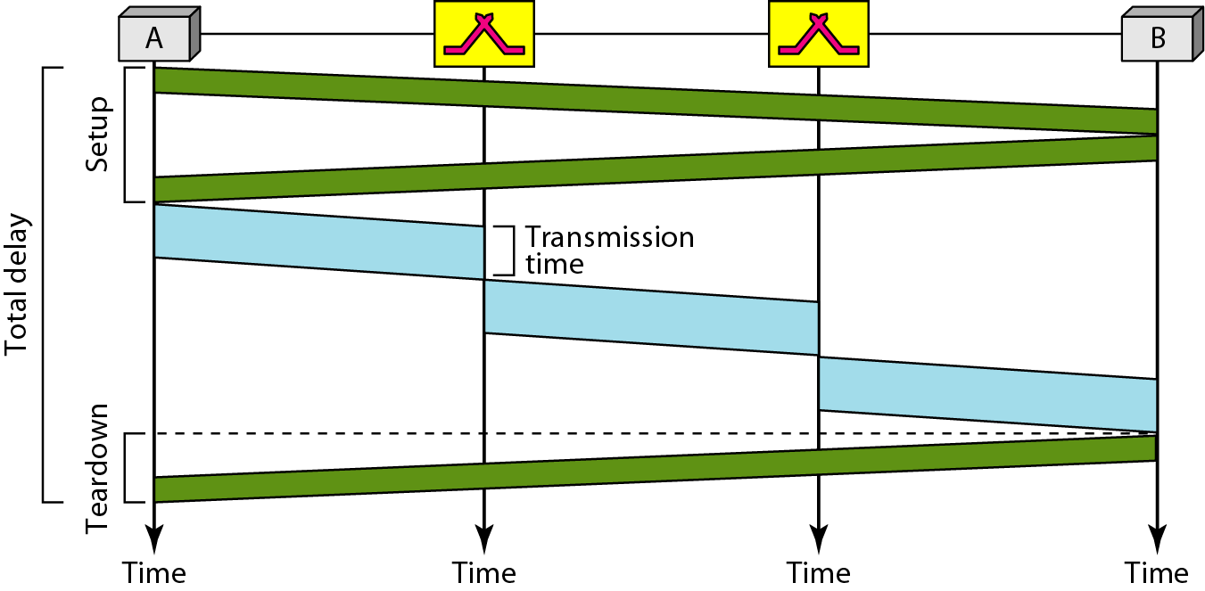
Figure Delay in a virtual-circuit network

Slide 33
Switching at the data link layer in a switched WAN is normally
implemented by using virtual-circuit techniques.

Slide 34
4. Structure of Switch
There are mainly two categories of switch based on network type.
Circuit switches and packet switches.

Slide 35
Taxonomy of switch using different type of networks
Switch structure
Circuit switches
Space-division switch
Crossbar switch
Multistage switch
Time-division switch
Time and space- division switch combinations
Packet switches
Banyan switch
Batcher-Banyan switch

Slide 36
Structure of circuit switches
It normally uses two technologies: The space division switch or the time division switch.
Space division switch:
In this switch paths in the circuit are separated from one another spatially.
Crossbar switch:
A crossbar switch connects n inputs to m outputs in a grid using electronic micro-switches at each crosspoint.
It required n * m cross point which is impractical.
It is also inefficient because of statistics. Only 25 percent of the cross points are in use at any given time.

Slide 37
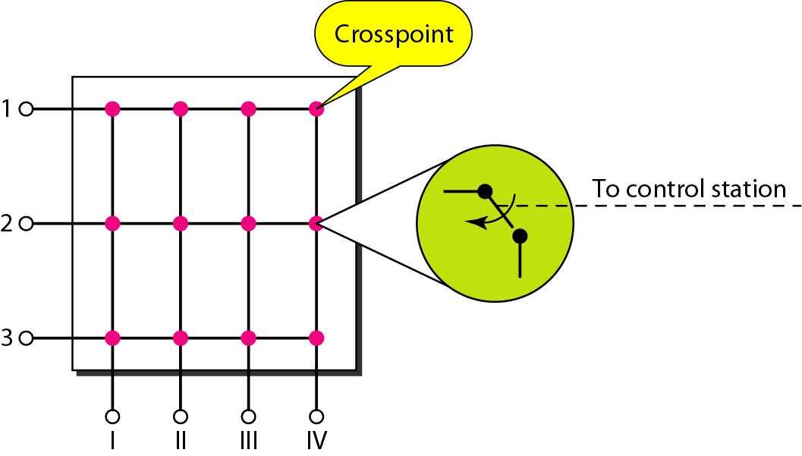
1. CIRCUIT SWITCHES
1.1 Space-division Switch: (a) Crossbar switch
Figure Crossbar switch with three inputs and four outputs

Slide 38
Structure of circuit switches
Multistage switch:
It normally combines three crossbar switches.
In a single crossbar switch, only one row or column is active for any connection.
So we need N* N cross points.
If we can allow multiple paths inside the switch we can decrease the number of crosspoints.
Each crosspoint in the middle stage can be accessed by multiple cross points in the first or third stage.

Slide 39
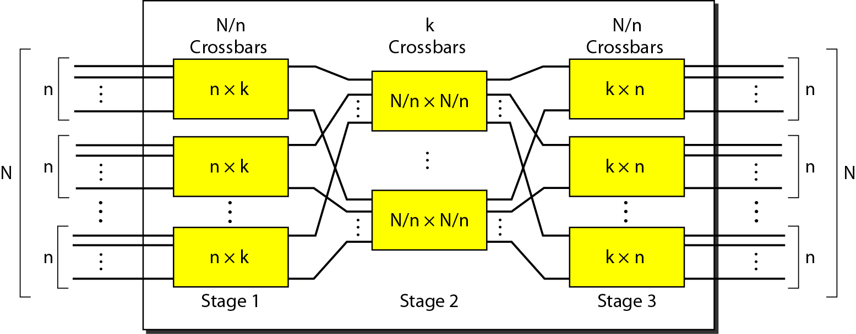
1. CIRCUIT SWITCHES
1.1 Space-division Switch: (b) Multistage switch
Figure Multistage switch

Slide 40
Structure of circuit switches
Time division switch:
It combines TDM multiplexer , a de-multiplexer and a TSI consisting of random access memory with several memory locations.
The size of each location is the same as the size of a single time slot.
The number of locations is the same as the number of inputs.
The ram Fills up with incoming data from time slots in the order received. Slots are then sent out in an order based on the decisions of a control unit.

Slide 41
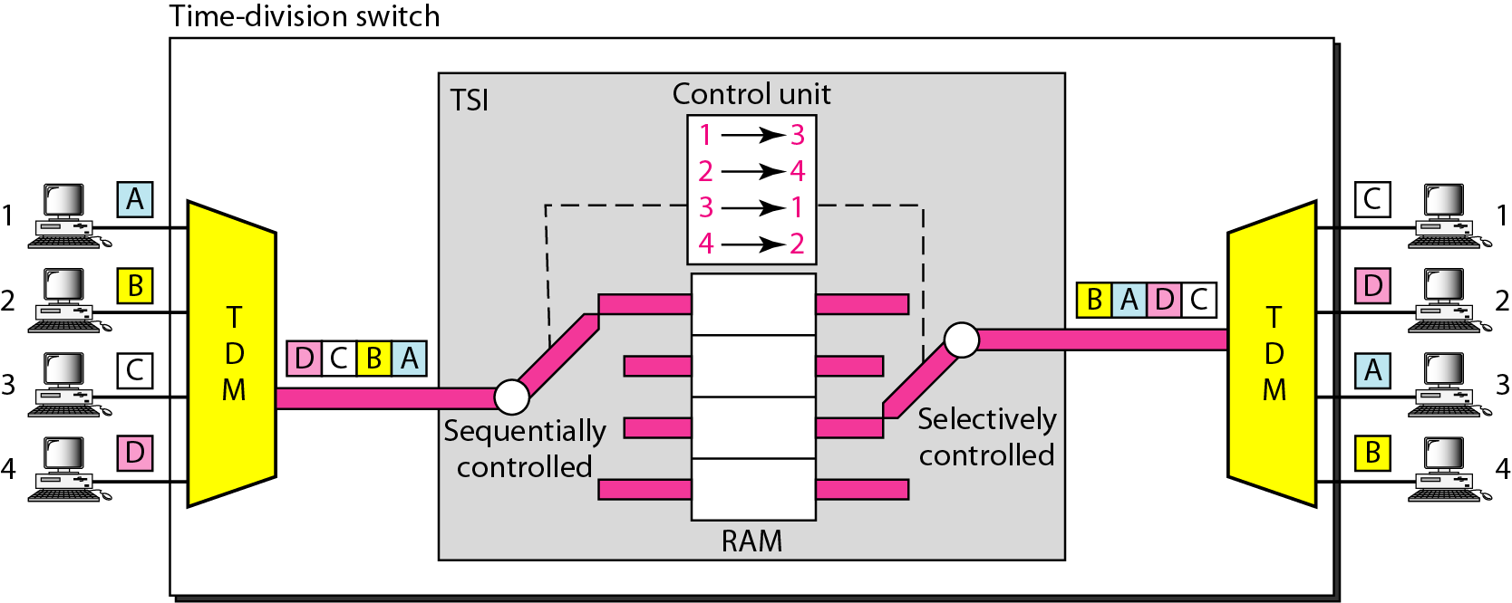
1. CIRCUIT SWITCHES
1.2 Time-division Switch
Figure Time-slot interchange

Slide 42
Structure of circuit switches
Time and space division switch combinations:
It is combination of both.
The advantage of space division is instantaneous. Disadvantage is the number of crosspoints required to make space division switching acceptable in terms of blocking.
The advantage of time division switching is that it needs no crosspoints. Diaadvantage is in the case of TSI processing each connection creates delays.
In TST switch there are two time stages and one space stage and has 12 inputs and 12 outputs.
Instead of one time division switch it divides the inputs into three groups( of four input each) and directs them to three time slot interchanges.
The result is that the average delay is one third of result from one time slot interchange to handle all 12 inputs.
The last stage is mirror image of the first stage. The middle stage is space division switch that connect the TSI groups to allow connectivity between all possible input and output pairs.

Slide 43
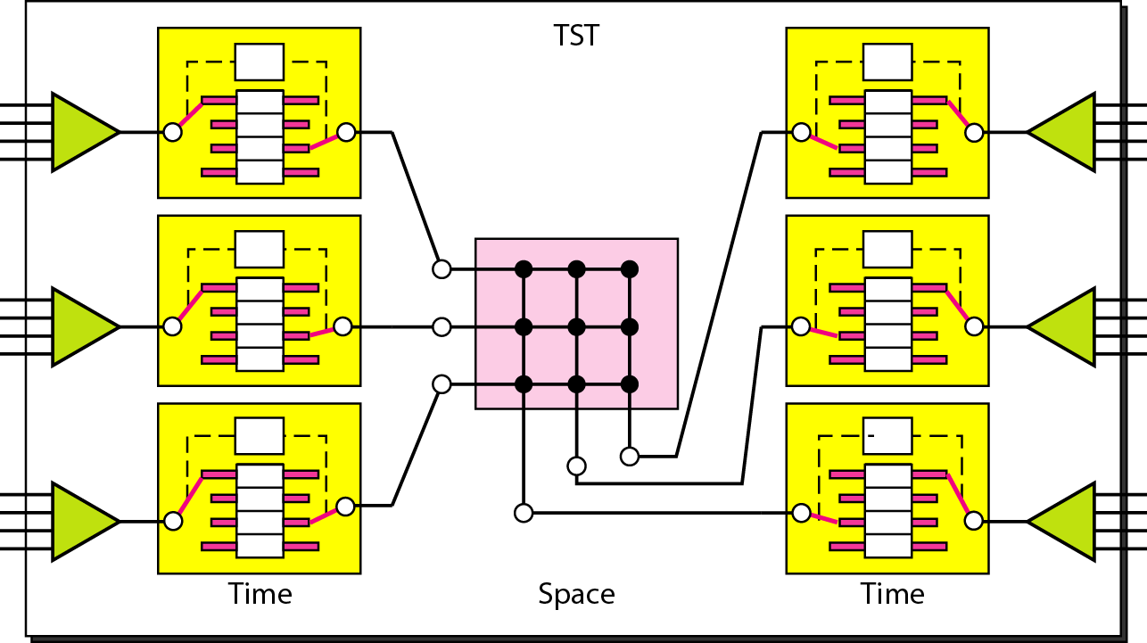
1. CIRCUIT SWITCHES
1.3 Time- and Space-division Switch Combination
Figure Time-space-time switch

Slide 44
Structure of Packet switches
Packet switch has four components: input ports, output ports, the routing processor, and the switching fabric.
Input Ports:
An input port performs the physical and data link functions of the packet switch.
The bits are constructed from the received signal. The packet is encapsulated from the frame. Errors are detected and corrected.
The input port has buffers to hold the packet before it is directed to the switching fabric.
Output Ports:
the output port performs the same functions as the input port but in the reverse order.
First packets are queued then it encapsulated in a frame and finally the physical layer functions are applied to the frame to create the signal to be sent on the line.

Slide 45
Structure of Packet switches
Routing Processor:
The routing processor performs the function of the network layer.
The destination address is used to find next hop then output port number from which packet is sent out.
It is called table lookup because the routing processor searches the routing table.
In new switches function switches to the input ports to facilitate and expedite the process.
Switching Fabrics:
It is used to move the packet from the input queue to the output queue.
There are two types of fabric crossbar switch and banyan switch

Slide 46
Crossbar switch fabric:
It is simplest type of switching fabric.
Banyan switch:
It is more realistic approach than crossbar switch.
It is a multistage switch with micro switches at each stage that route the packets based on the output port represented as a binary string.
For n inputs and outputs we have lon2n stages with n/2 micro switches at each stage.
The first stage routes the packet based on the high order bit of the binary string.
The second stage routes the packet based on the second high order bit and son on.
It problem with this switch is internal collision even when two packets are not heading for the same output port.
This problem can be solve by sorting the arriving packets based on their destination port.

Slide 47
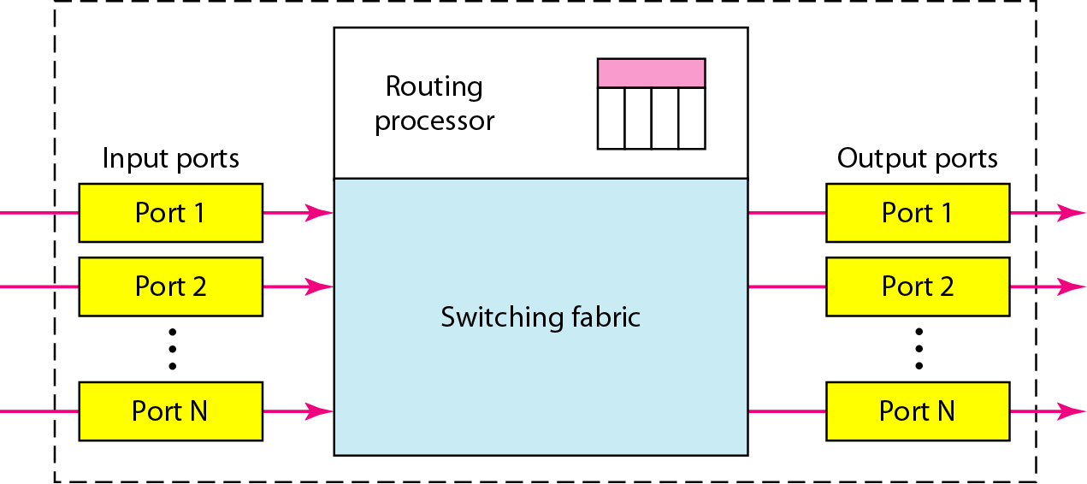
2. PACKET SWITCHES
Figure Packet switch components

Slide 48
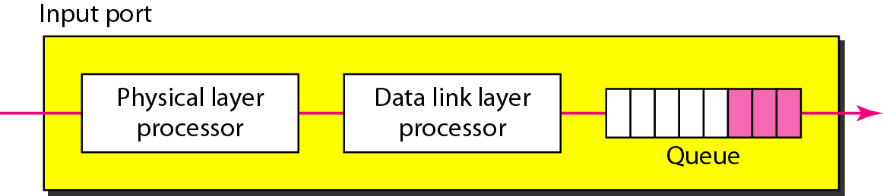
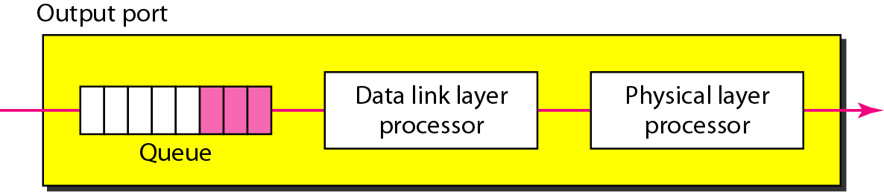
Components of Packet switches
Figure Input port
Figure Output port

Slide 49
Components of Packet switches
Routing processor
Performs functions at Network layer
Also known as Table lookup
Destination address is used to find address of next hop & output port no. (of source)
Switching Fabrics
Used to move packet from input queue to output queue
Crossbar switch
Banyan switch
Batcher-Banyan switch

Slide 50
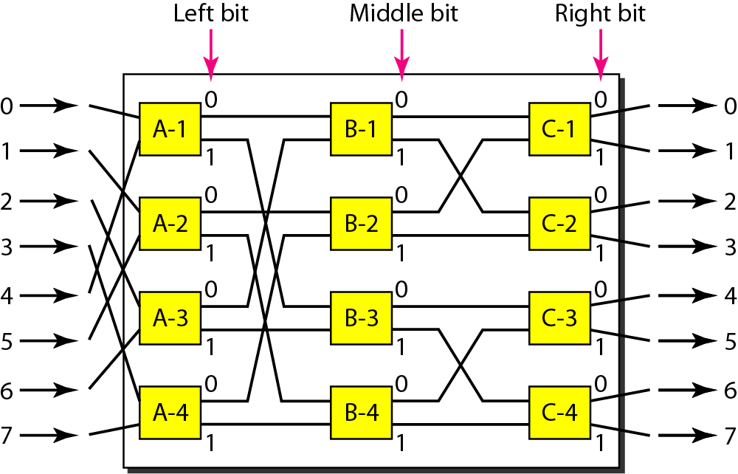
Figure A banyan switch

Slide 51
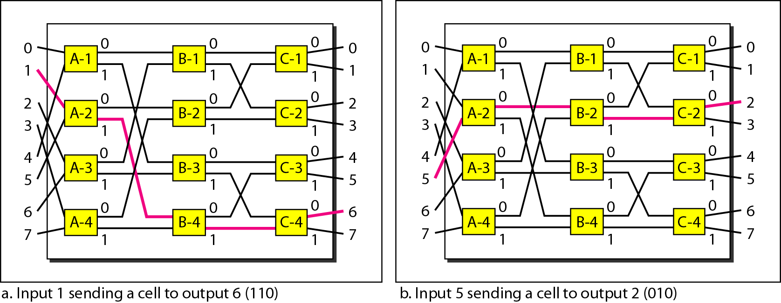
Figure Examples of routing in a banyan switch

Slide 52
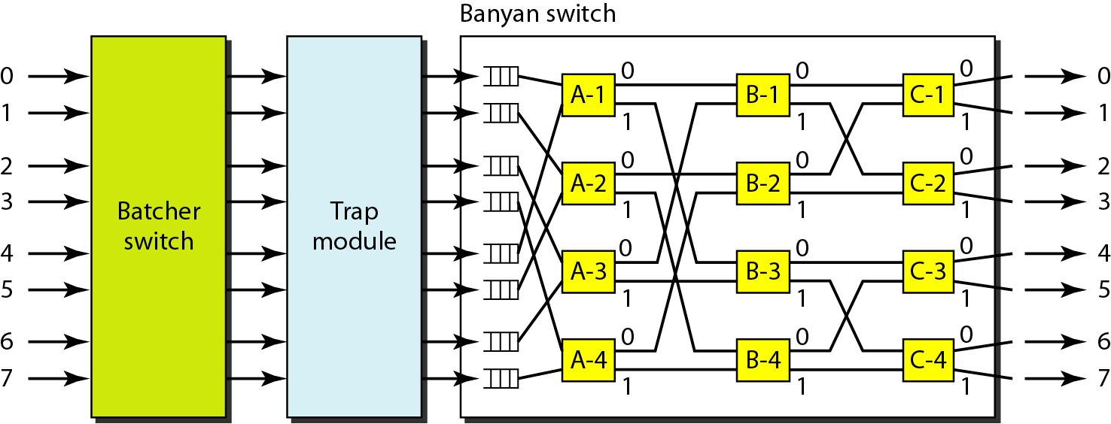
Figure Batcher-banyan switch

Slide 53
Thank You

